Slide 1
How to Automate using Pytest
Georgiana Moise

Slide 2
Objectives
Start automation on a new product
Automation standards

Slide 3
Pytest framework

Slide 4
Overview
Execution engine: pytest
Requirements: minimum Python 3.7
Web interface: reportportal plugin
Requirements: Ubuntu 18.04&above server

Slide 5
How to install pytest
Make sure python is installed ( python --version or python3 --version)
Install pytest
pip install pytest
Note! Verify the installation was successful with pytest --version
Install framework and update plugin changes
cd framework_directory\
python setup.py install

Slide 6
Pytest naming conventions
Pytest collects testcases only if the following naming conventions are followed
Testcase method name starts with: test_
E.g def test_demo(fixture1, fixture2):
Python file that contains testcases should be named: test_<custom_name>.py
E.g. sisyphos_tests\tests\custom\test_custom_demo.py
Classes that contain testcases should start with: Test…
E.g Class TestDemo
Fixtures and helpers can be added also in files named conftest.py
These files are automatically imported and all functionality is available in the testcases
There is one general conftest file that applies to all directories, found in tests/conftest.py
Feature custom conftest files can be added in each feature directory

Slide 7
Testcases
Subdirectory for testbed configuration file
Subdirectory for suitemaps - testcase definition list
Subdirectory for runlists - list of testcases, grouped by feature/testplan/product/platform
Subdirectory for testcases – directories with automated testcases, grouped by testplan/product
Framework
Directory with APIs for accessing and configuring DUTs
Subdirectories for grouping different areas.
E.g. API for sending commands to a DUT and return the output
Recommended repositories
Infrastructure
Infrastructure API (building different components, adding custom functionality, low level access to devices)
E.g API for connecting to a DUT
Utils
Helper methods, generally available

Slide 8
Writing a testcase

Slide 9
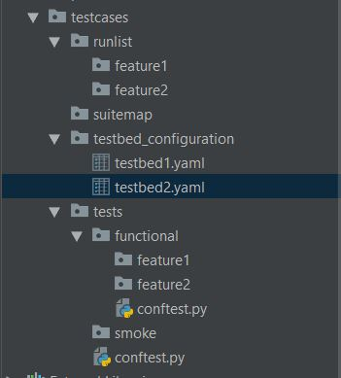
testcases repository

Slide 10
Topology
Steps to create a testcase
Testplan directory
Create testplan/platform folder (if not exists) in testcase directory
Testcase class
Create class file for each subsection/logical grouping of testcases in testplan
Create suite setup, testcase setup, testcases (see following slides for details)
Suitemap
Create testcase
Create a directory for every feature and add suitemap
Runlist
Create list of testcases, grouped by feature in runlists directory

Slide 11
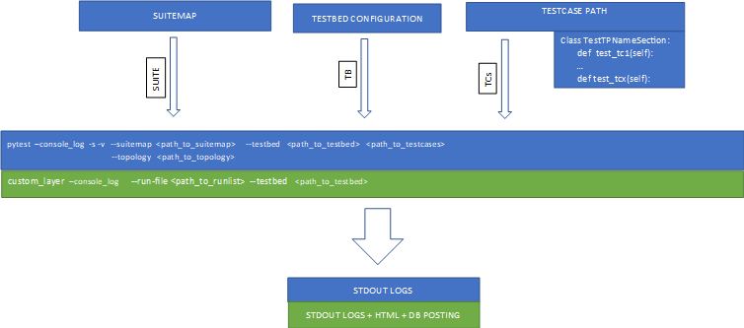
Running a testcase

Slide 12
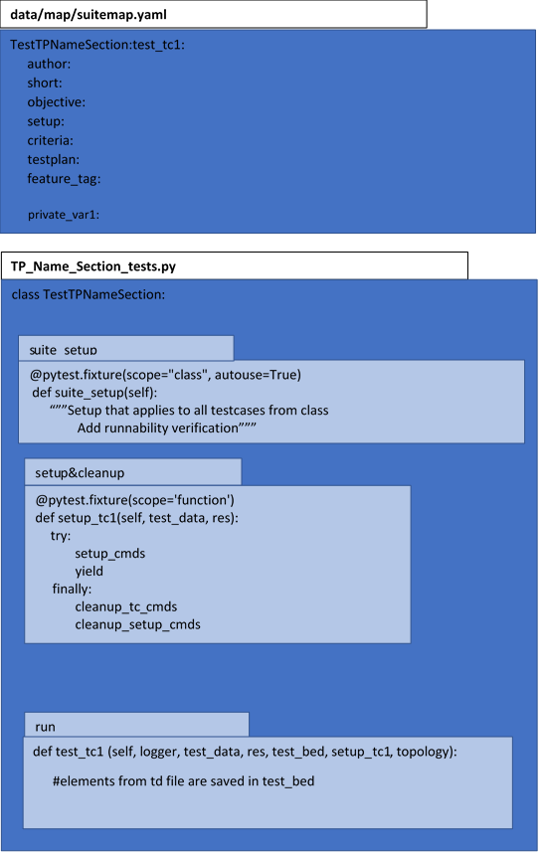
Testcase class

Slide 13
Pytest fixtures
They are python functions that are executed by pytest.
They can be requested in our testcases.
They can have the flag autouse=True to be executed before testcases without being specifically requested.
They can have different scopes which determine how often the fixtures are executed:
Session scope
Module scope
Class scope
Function scope

Slide 14
Conftest file
Contains hooks and fixtures used by testcases
The scope is limited to the directory and its subdirectories where the conftest.py file is located
Testcases located in same directory with this conftest.py file (or in subdirectories) can then directly request and use pan1_cli

Slide 15
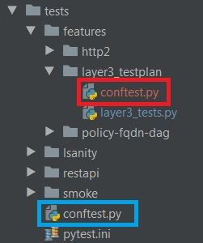
Layering conftest files
We can have conftest.py files located on different levels.
All tests located in tests/layer3_testplan will have access to both files and the fixtures defined in them.
Testcases located directly under tests/ directory or in another subdirectory (e.g. http2) will have access only to the blue framed conftest.py and its fixtures
If a fixture has the same name in both conftest.py files, the definition from the lower level (red) conftest.py file will take precedence.

Slide 16
Create methods

Slide 17
Steps to create a method
Find similar methods
Verify if the method you need to use is not already implemented.
Maybe you need to extend it, not create it from scratch
Find location
Methods can be found in framework repository
Naming convention
Create a Confluence document with naming conventions
Implementation
Verification
Verify your method is running as expected.
If UT available, make sure they still pass.

